Slide 1

Health plus
A novelty in healthcare moderation

Slide 2
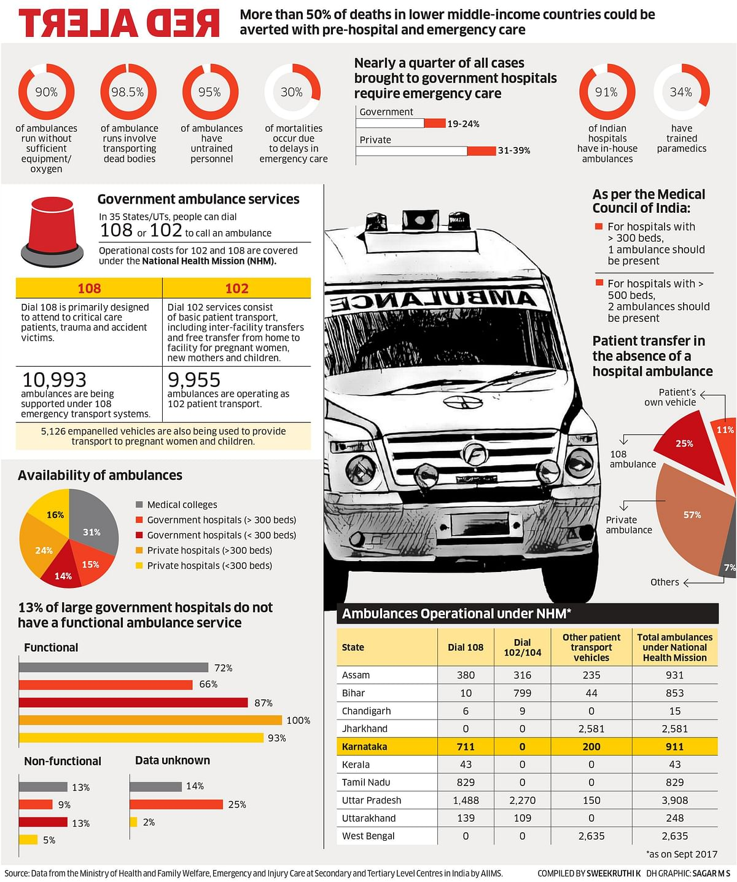
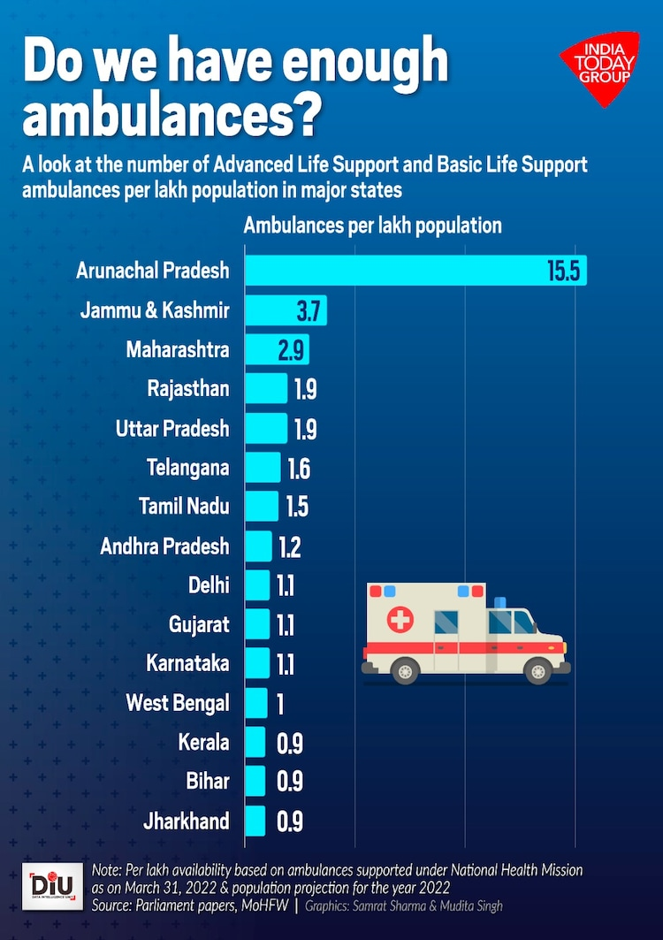
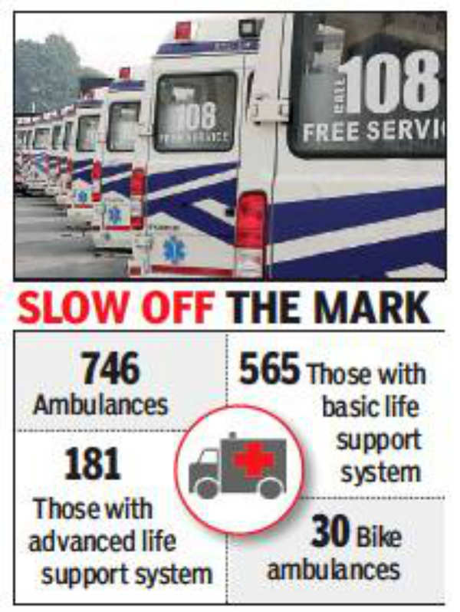

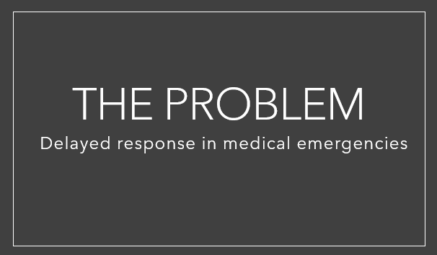
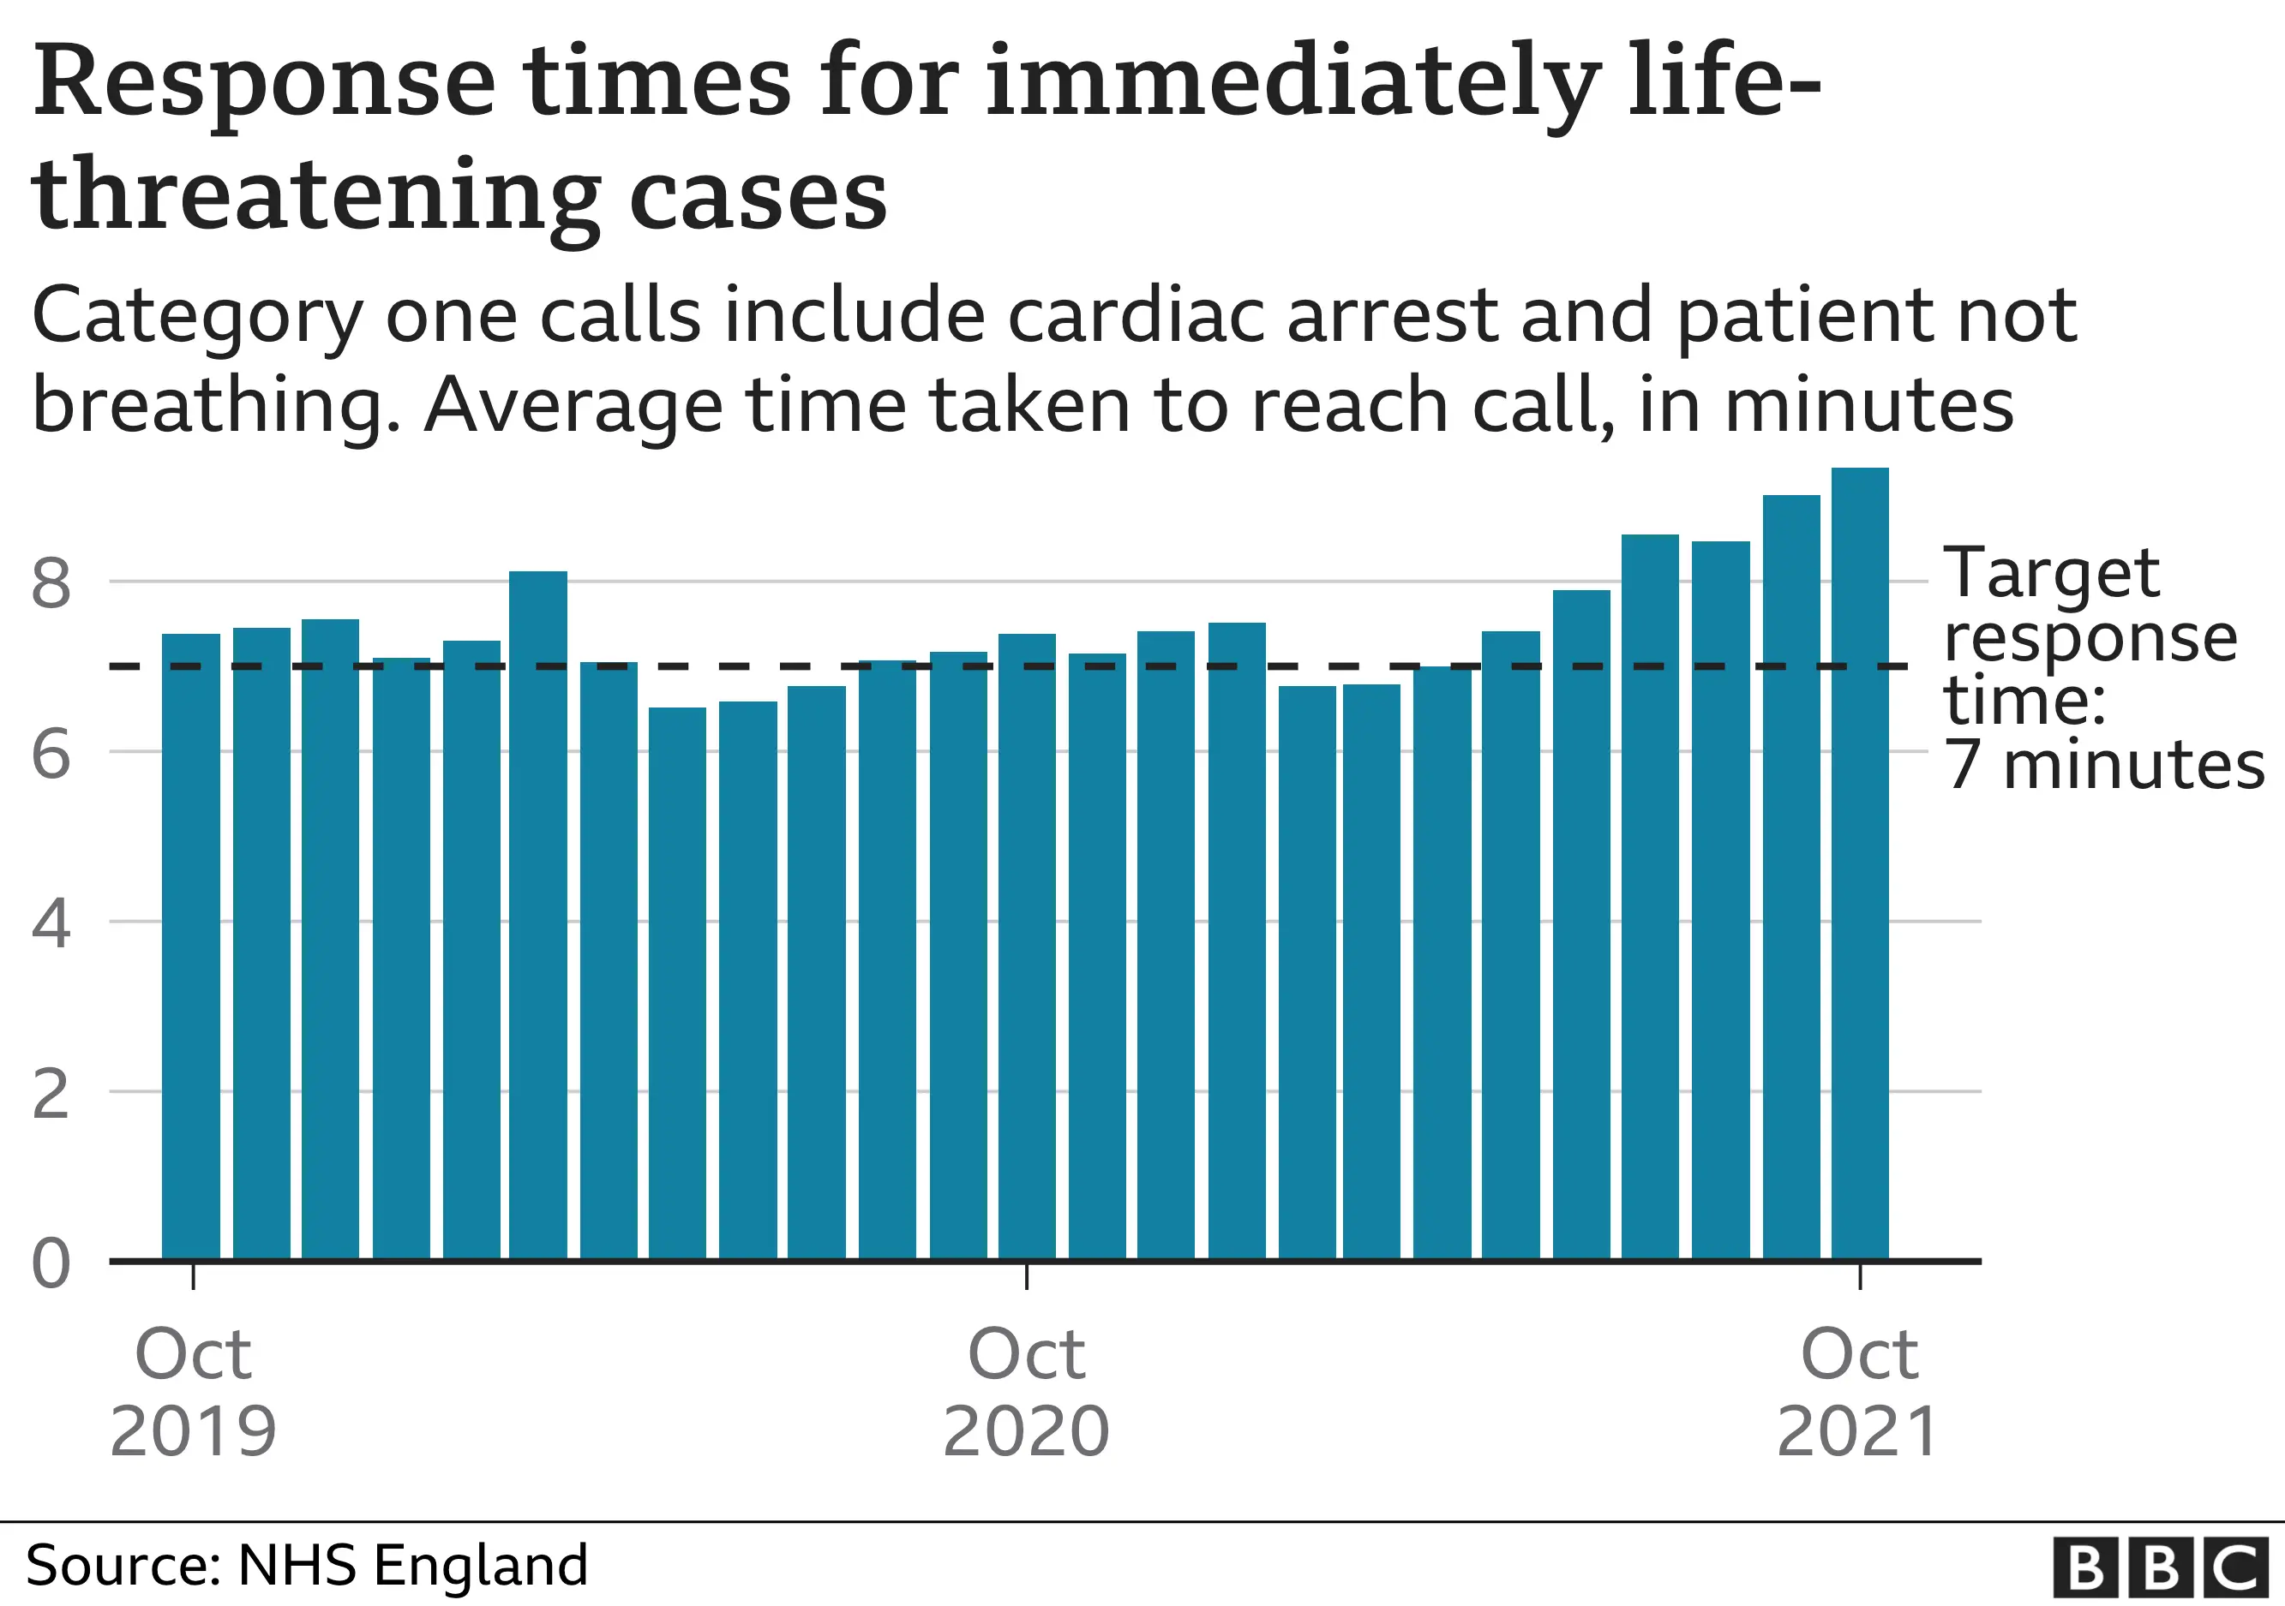
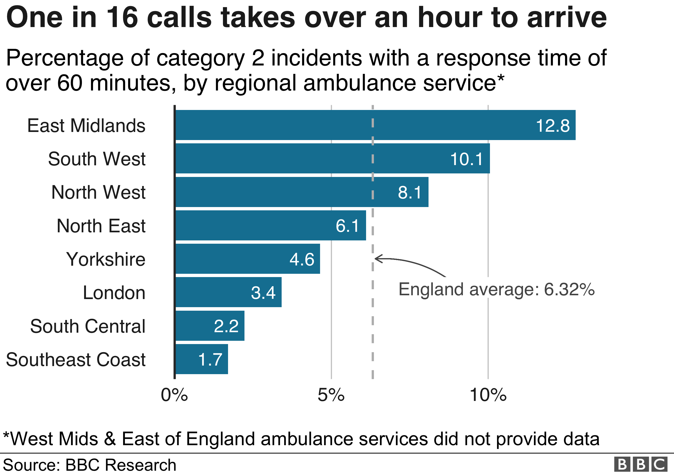

Slide 3
Centers of Intervention
Patient
When the patient calls for an ambulance, the time of the call and the patient's location are recorded.
Ambulance
As soon as the ambulance is dispatched, an entry is made, including its live location.
Another entry is recorded when the ambulance picks up the patient.
Hospital
The hospital records an entry when the patient arrives.
Additionally, another entry is made in the network to document the prescribed medications.
Pharmacy
The pharmacy reviews the hospital's entry and dispenses the medication to the patient. They then make a final entry to indicate that the patient has been served.

Slide 4


Thank You
Preetham Sivalingam

